Slide 1
Recipe redux
By: Devin Rayfield
Advisor: Mitchell Neilsen

Slide 2
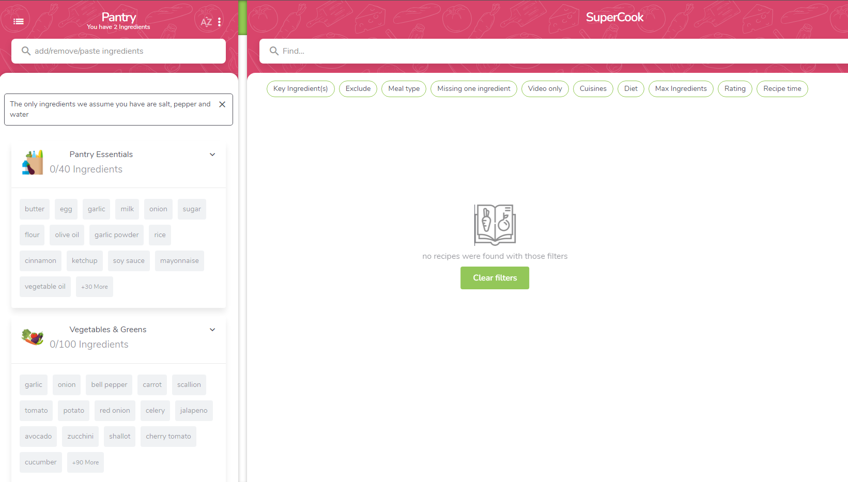
introduction
Recipe Redux – Recipe App
Inspiration: SuperCook
Why switch projects?

Slide 3
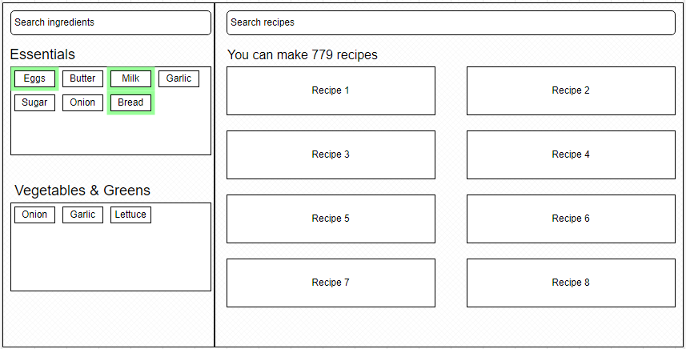
UI Design

Slide 4
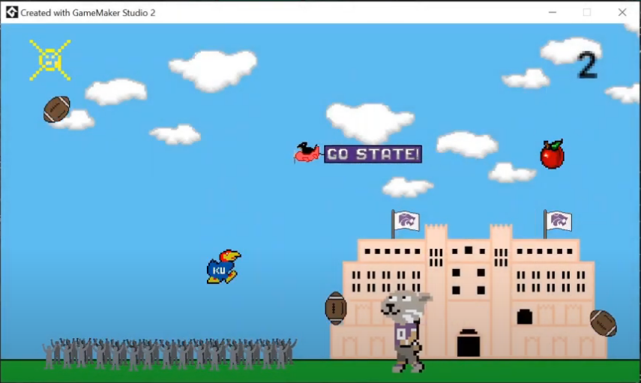
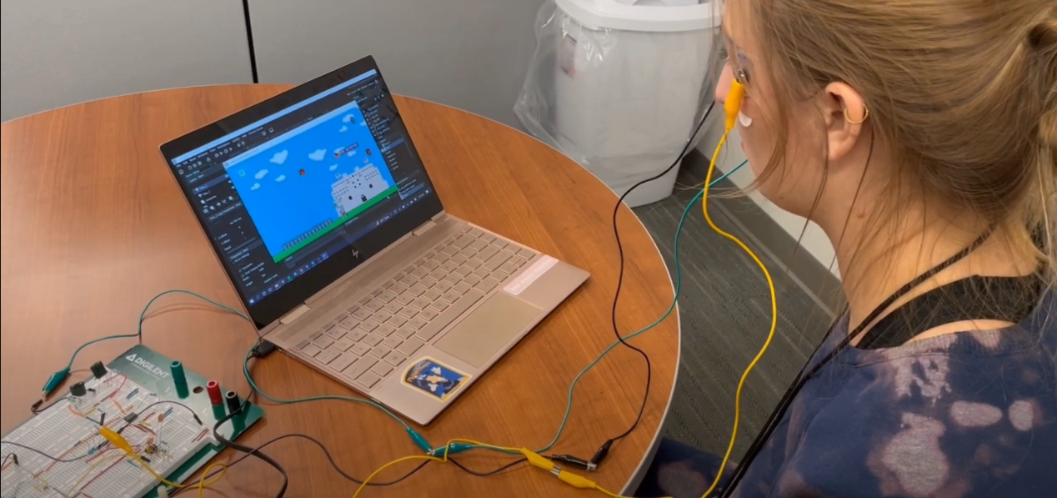
background
Majority of background is C#
Qualifications: 2021 K-State Hackathon Video Game Winner

Slide 5
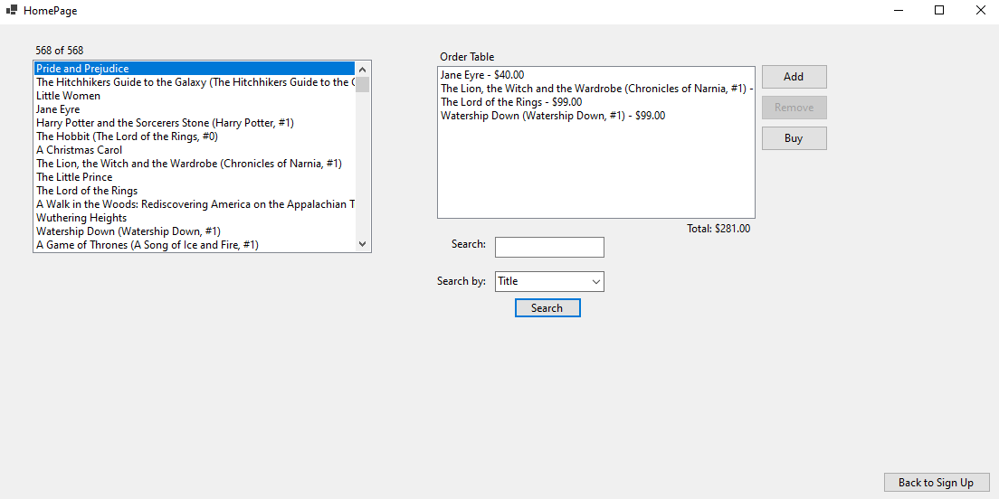
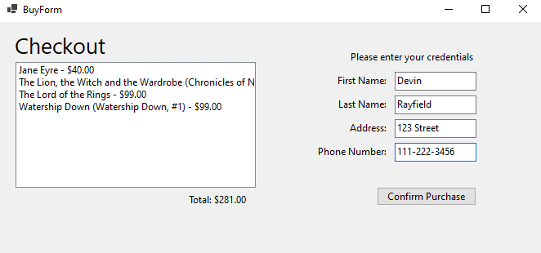
background
CIS 560 Project – Online Bookstore

Slide 6
Project requirements
Problem: College students on a budget! Lack of options.
Solution: Give me what you have, I’ll tell you what you can make!
MVP:
Ingredient Selection
Pantry
Basic Recipe Display

Slide 7
OG Versions 1.0 / 2.0
User Authentication
Recipe Filtering
Grocery List
Interactive Pantry
User Profile Management
Export Recipes
Social Sharing

Slide 8
Updated Versions 1.0 / 2.0
User Authentication
Interactive Pantry
Recipe Filtering
MAKE IT PRETTY!!!!!!!
Export Recipes
Social Sharing

Slide 9

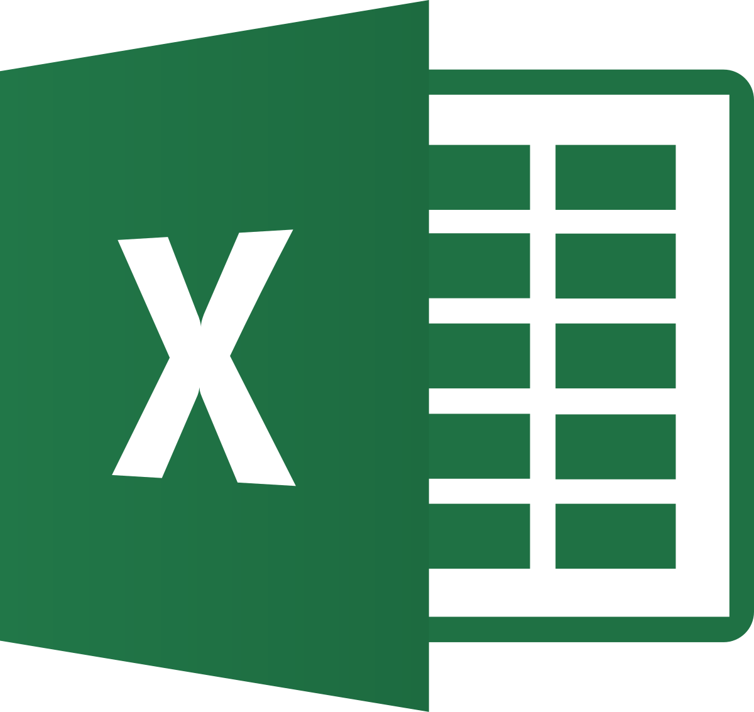


Implementation
C#
Visual Studio – Windows Forms
Microsoft SQL Server Management Studio
VS Code – Python scripts
Draw.IO – Diagrams
Excel - Dataset

Slide 10
Implementation
Obtained Recipe CSV from Kaggle (Food.com)
Imported into SSMS
Parsed / reformatted columns in SSMS and VS Code using SQL queries and Python scripts
Majority written in C# in Visual Studio
~1,500 lines of code total

Slide 11
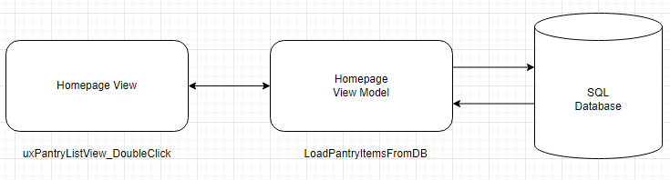
Design
MVC Design Pattern

Slide 12
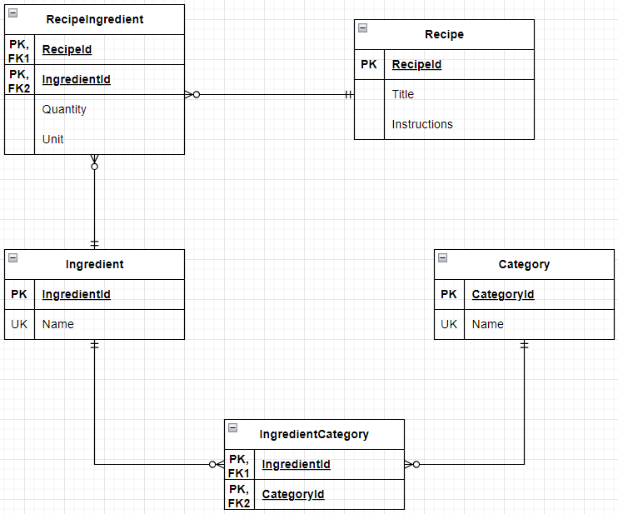
Database

Slide 13
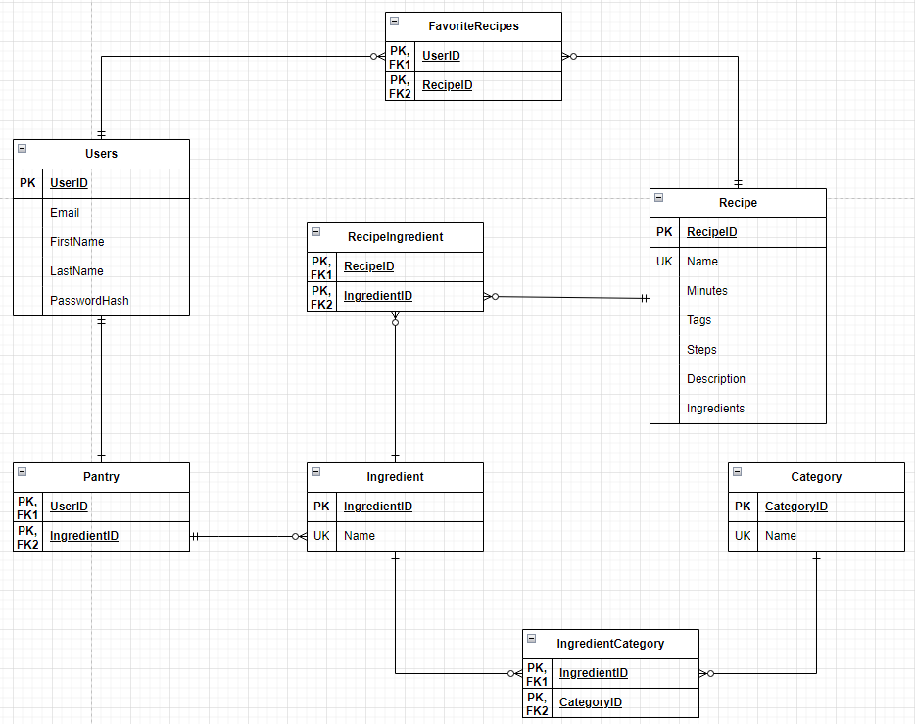
Database

Slide 14
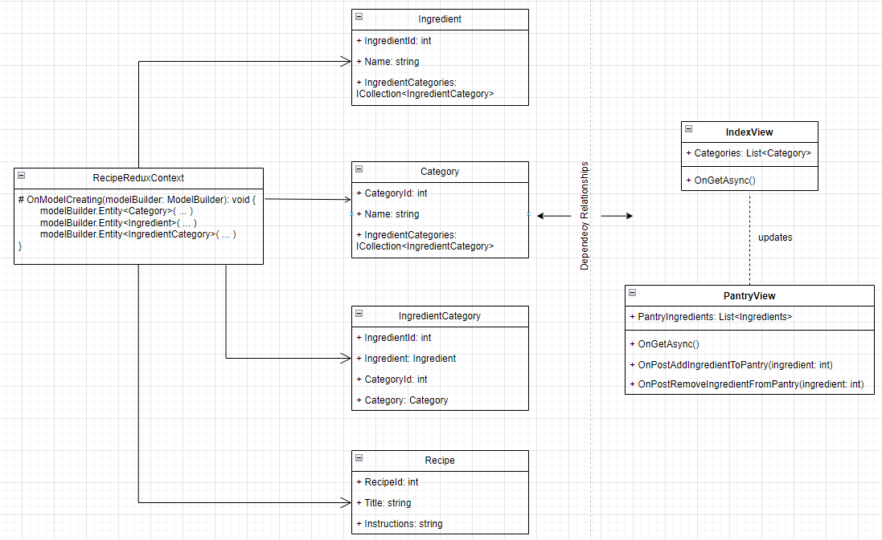
UML
Notes:
Original UML diagram for razor pages

Slide 15
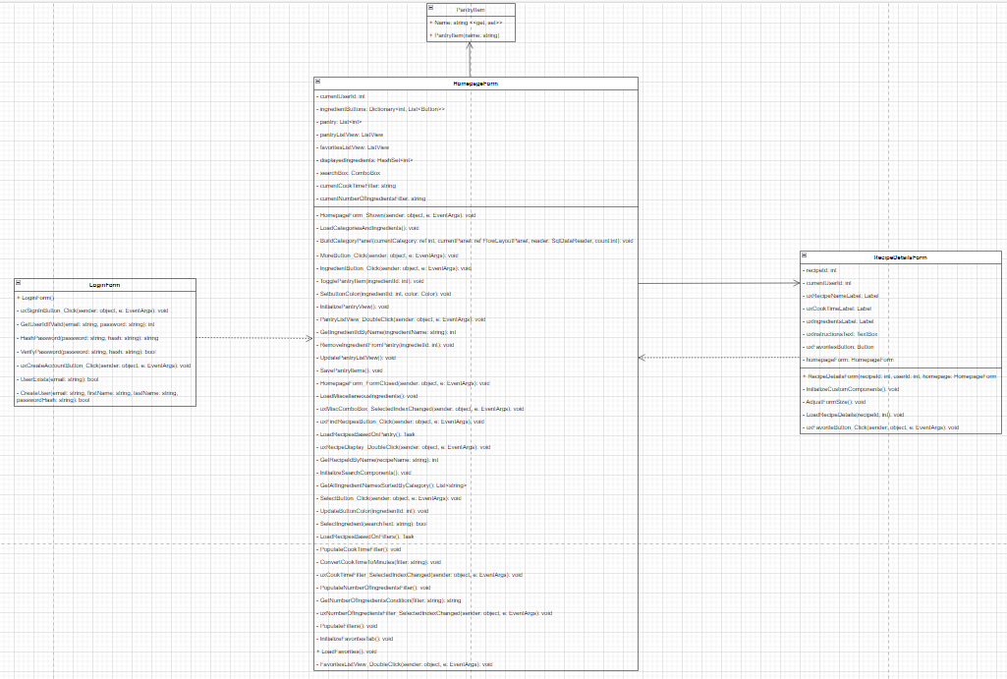
UML

Slide 16
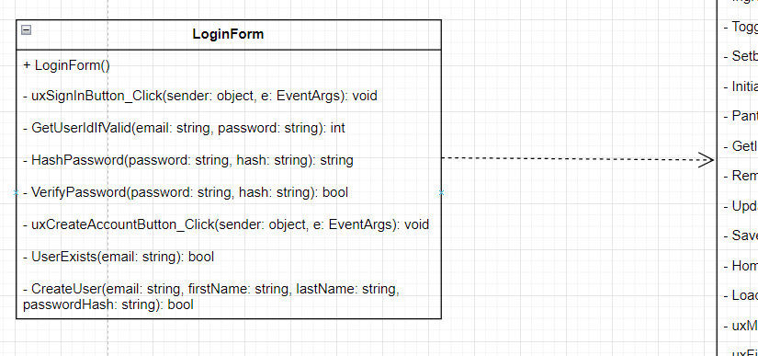
Notes:
Dependency arrow pointing from LoginForm to HomepageForm because the LoginForm creates and depends on the HomepageForm

Slide 17
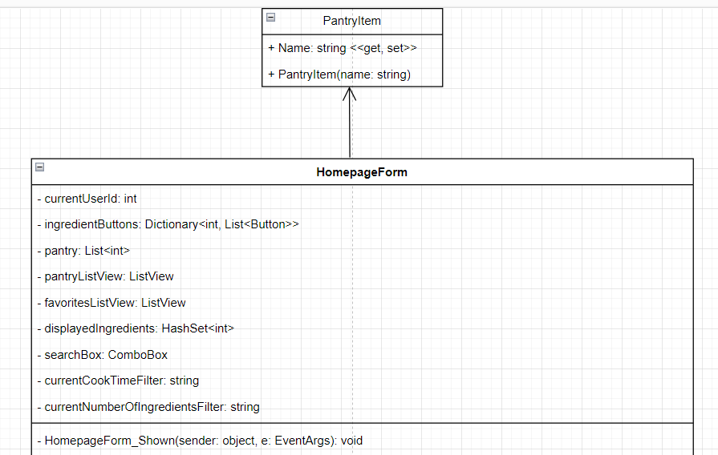
Notes:
Association arrow from HomepageForm to PantryItem because the HomepageForm uses a collection of PantryItem objects

Slide 18
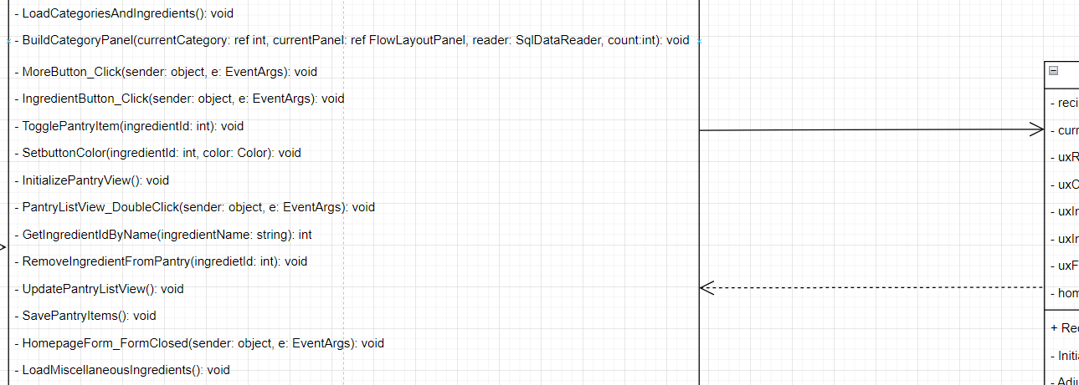
Notes:
Arrow from HomepageForm points to RecipeDetailsForm because the HomepageForm creates and shows instances of the RecipeDetailsForm when a user clicks on a recipe

Slide 19
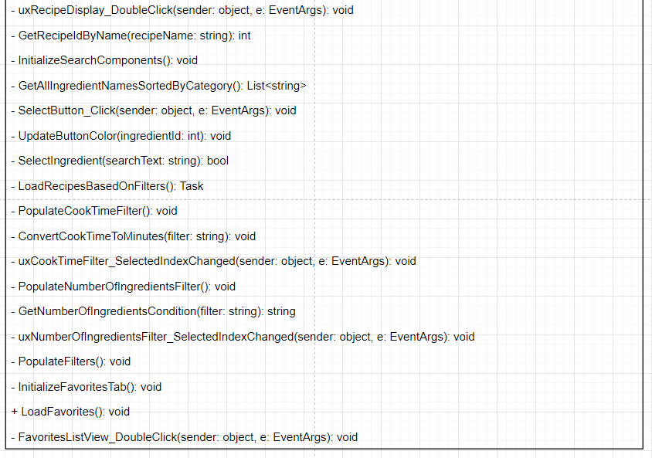

Slide 20
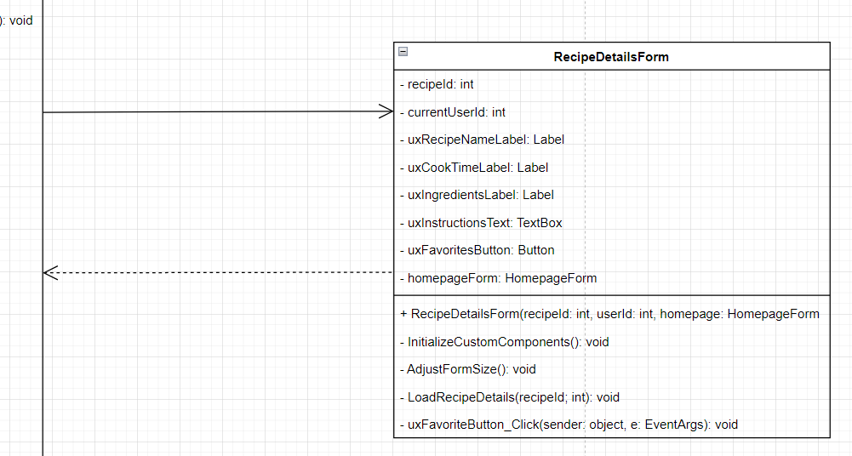
Notes:
Arrow from RecipeDetailsForm points to HomepageForm because the RecipeDetailsForm depends on the HomepageForm to refresh the favorites list in the favorites tab

Slide 21
Front end

Slide 22
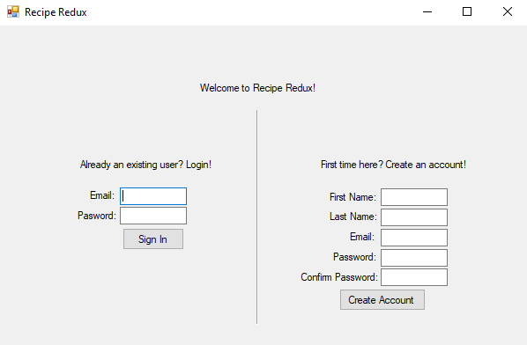
Sign in/up

Slide 23
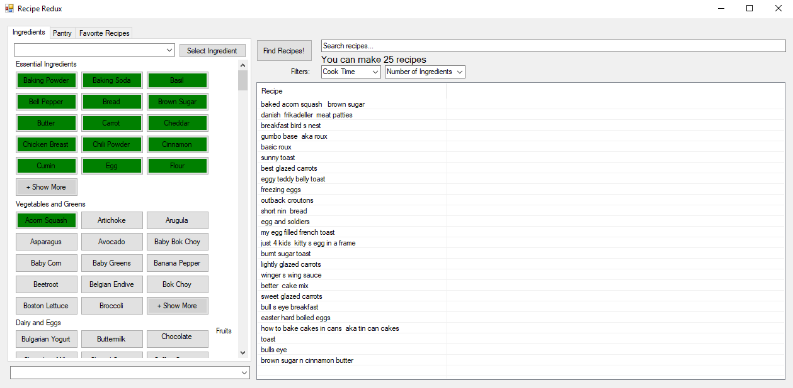
Homepage

Slide 24
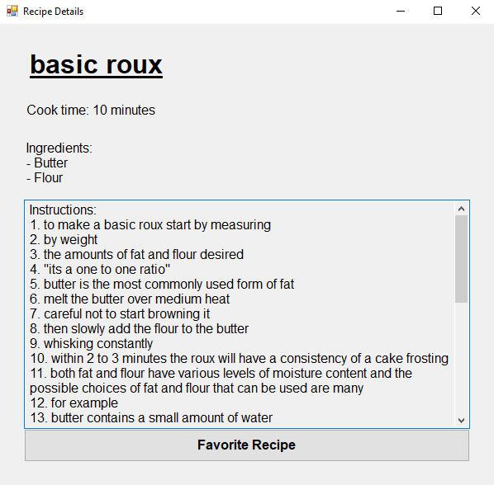
Favoriting a Recipe

Slide 25
Back end

Slide 26
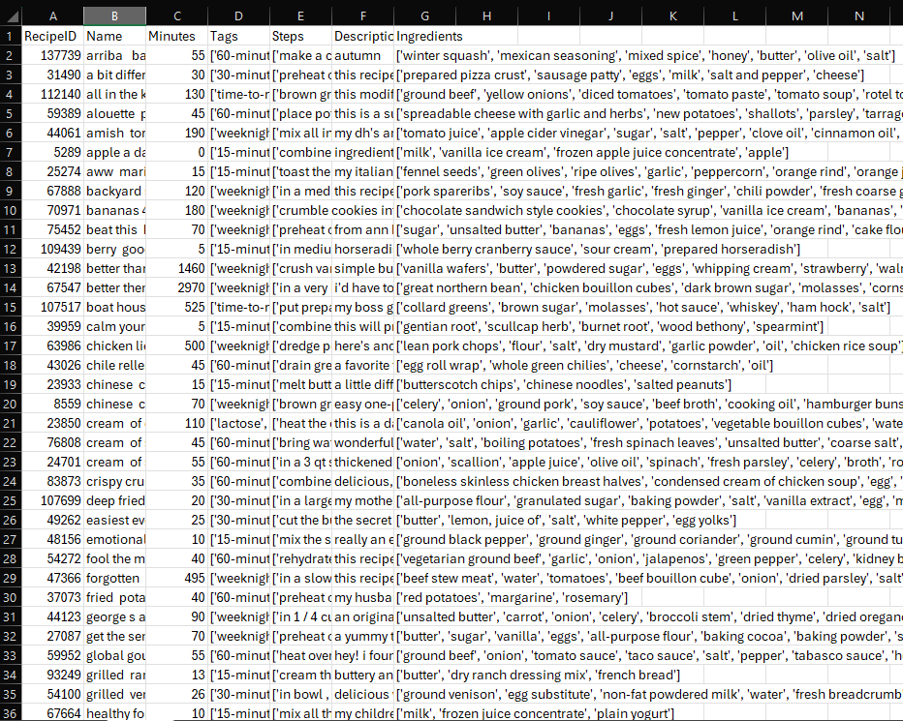
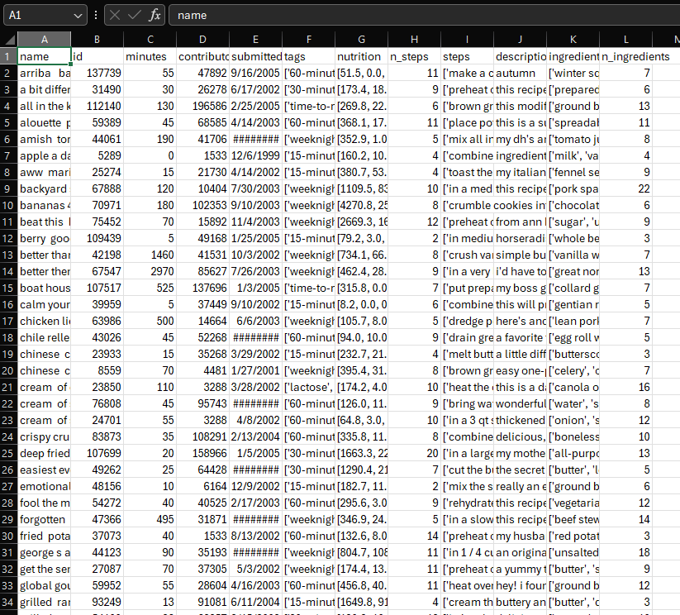

Slide 27
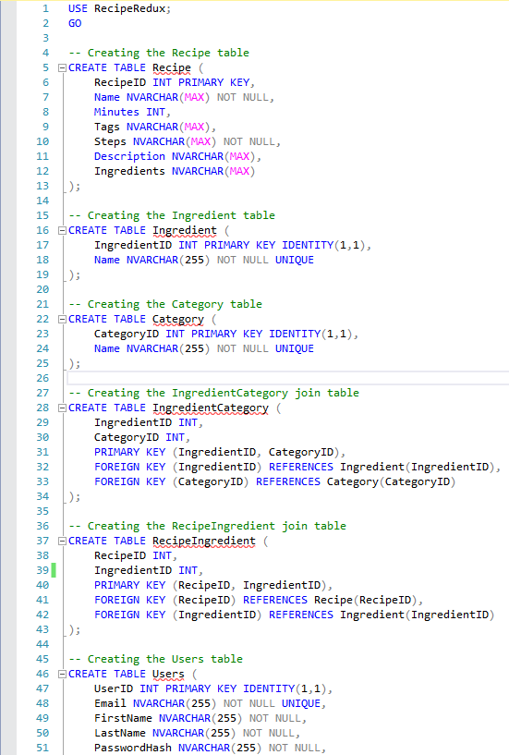
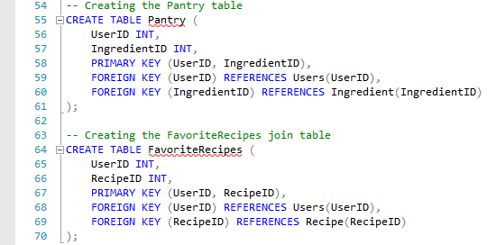

Slide 28
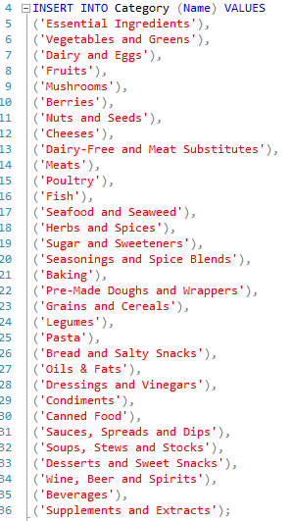
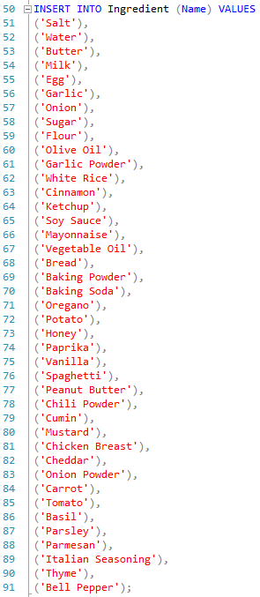
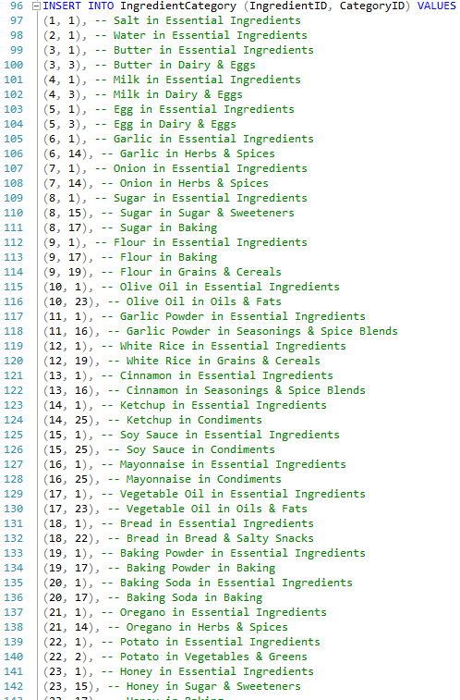

Slide 29
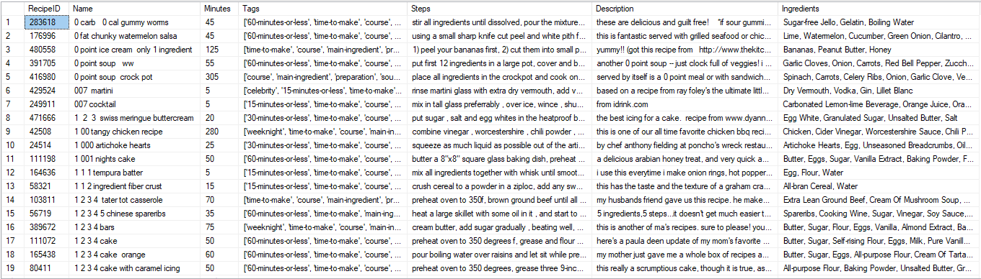

Slide 30
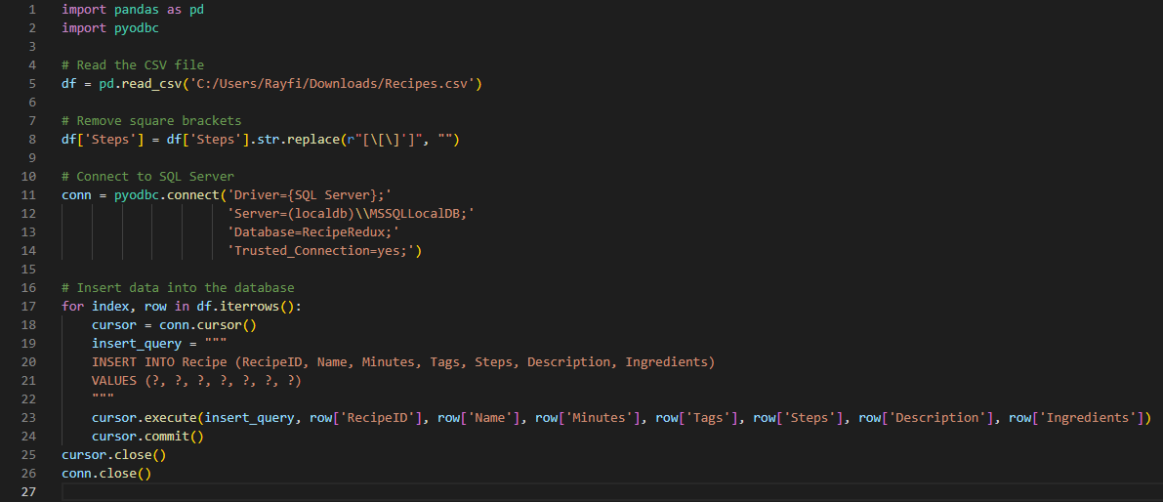

Slide 31
Testing
Manual
Basic use cases:
Create account
Display correct recipes
Update pantry correctly

Slide 32
issues
Keeping track of button/pantry states
Have “miscellaneous” category as a combo box at bottom
Poor data formatting (ingredient names/recipe steps) // Wanted images/nutrition information
Processing efficiency of forms vs razor pages

Slide 33
Packaging and Deployment
Download zip files from GitHub
Unzip files
Figure out how to use .exe?????
Users need Visual Studio/SSMS?
Change connection string if applicable

Slide 34
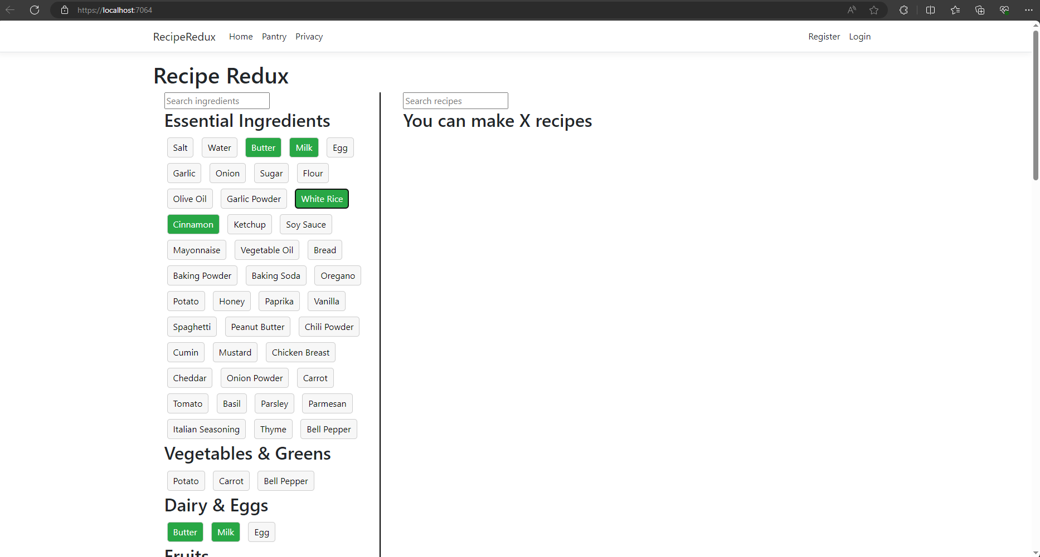
Hopefully turn it into a website one day…

Slide 35
demO!!!!

Slide 36
Future work
MAKE IT PRETTY!!!!!!!
Make more efficient
More filters
Export Recipes
Social Sharing

Slide 37
Conclusion
Questions?
Notes:
Project isn’t 100% done yet but I’m very close to everything I wanted to achieve. Are there any questions?

